Slide 1
Lead Scoring Case Study
Group:
Siva Gopavarapu
Manan Sharma
Saheli Paul

Slide 2
Background
X Education , An education company named sells online courses to industry professionals
The company markets its courses on several websites like Google. Once these people land on the website, they might browse the courses or fill up a form for the course or watch some videos
Once these leads are acquired, employees from the sales team start making calls, writing emails, etc. Through this process, some of the leads get converted while most do not
The typical lead conversion rate at X education is around 30%

Slide 3
Problem Statement
Build a logistic regression model to predict the probability of lead conversion which can be used by the company to target potential leads
Propose the changes which will help to increase the conversion rate
The CEO, in particular, has given a ballpark of the target lead conversion rate to be 80%.

Slide 4
Case Study Implementation
Get the data provided by the company
Perform the data analysis and build graphs to understand the relation between variables
Gather Data
Clean Data
EDA
Data Preparation
Build Model
Clean the data such as null value treatment, outliers
Scale the numerical columns and use rfe for variable selection

Slide 5
Selection of top 15 features using RFE
Check the p value and vif to change the columns for model
Feature Selection
Model Building
Model Improvement
Final Model
Model building using RFE for selected columns
Analyse the final model based on accuracy, sensitivity, and specificity

Slide 6
Graphs from EDA

Slide 7
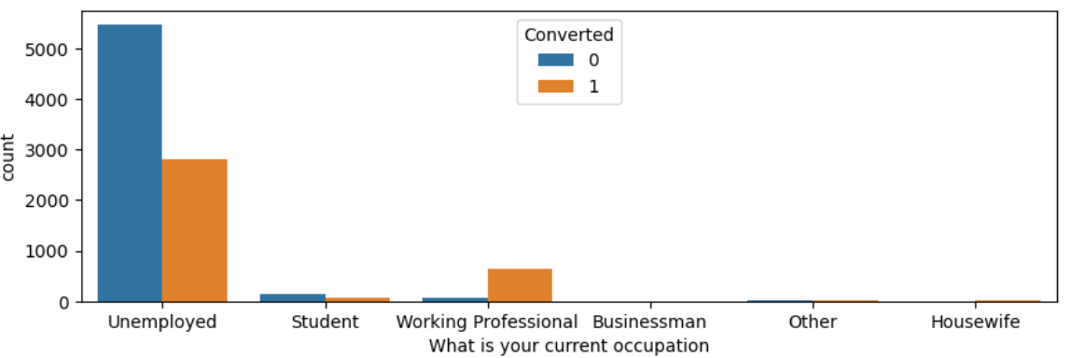
Occupation Vs Converted
It’s clear that working professionals are having very high chance of conversion

Slide 8
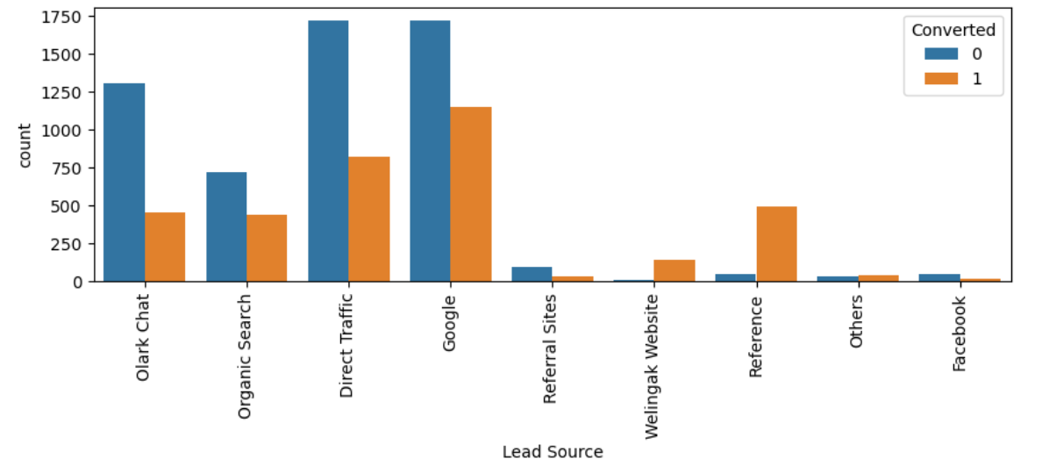
Lead Source Vs Converted
Proportion of leads converted is highest in reference followed by welingak_website
Maximum number of leads are from direct traffic and google
Organic search also has good conversion rate
Concentrate on increasing the reference and organic search lead base for more conversion

Slide 9
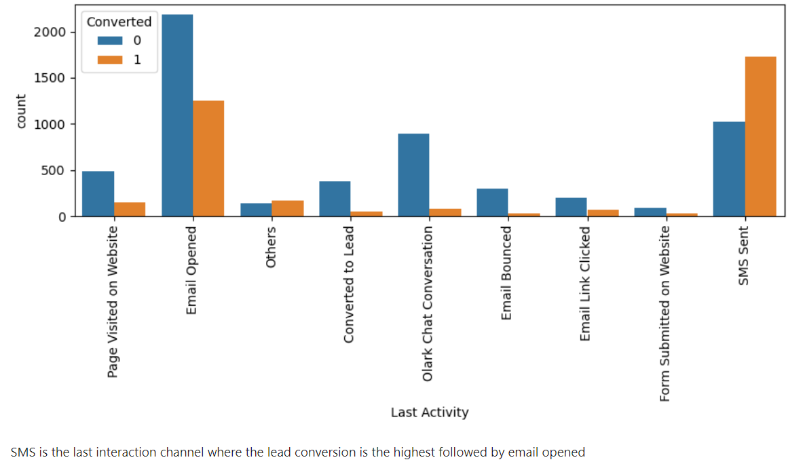
Last Activity Vs Converted

Slide 10
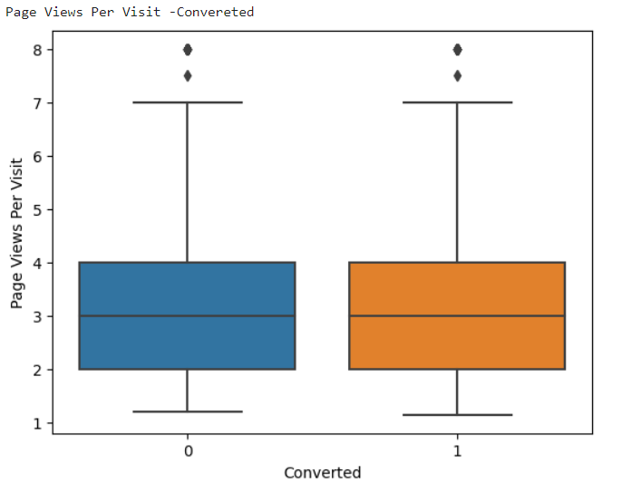
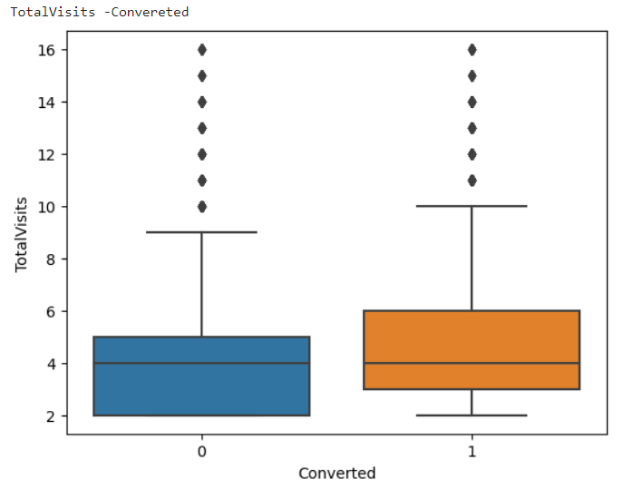
Pages View Per Visit and Total Visits Vs Converted

Slide 11
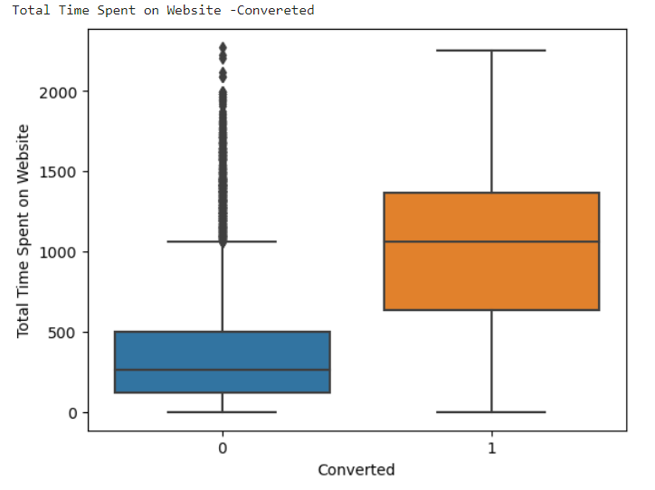
Total Time Spent on Website
Leads who spend more time on website have higher change of conversion

Slide 12
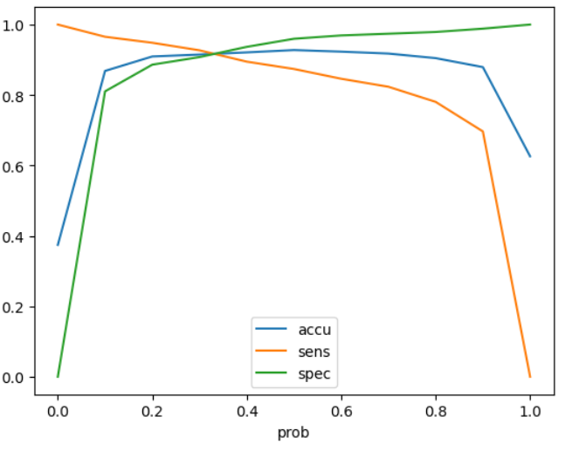
Select Optimum Cutoff Value
0.3 is the optimum cutoff value for the LogisticRegression model

Slide 13
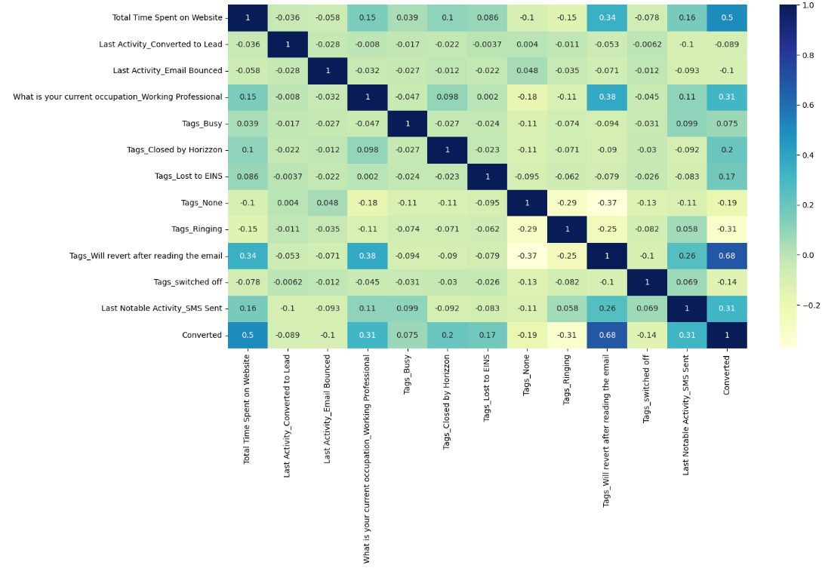
Heatmap to see the correlation

Slide 14
Conclusion from the model
Top 3 predictor variables:
Tags_Will revert after reading the email
Total Time Spent on Website
What is your current occupation_Working Professional / Last Notable Activity_SMS Sent

Slide 15
Train and Test dataset metrics
Training:
Accuracy: 91.48%
Sensitivity: 92.68%
Specificity: 90.76%
Testing:
Accuracy: 91.57%
Sensitivity: 92.11%
Specificity: 91.24%

